Slide 1
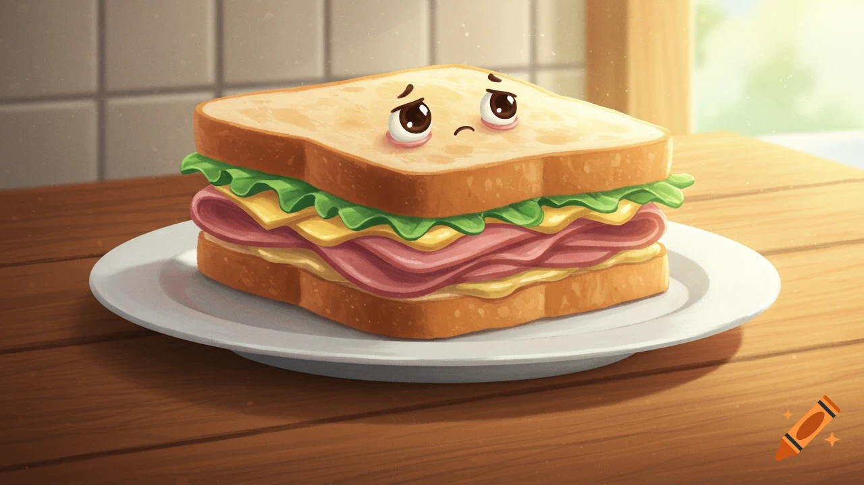
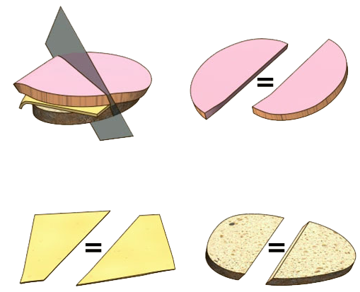
Ham Sandwich Theorem. There exists a cut that equally partitions three toppings (bread, ham, cheese)

Slide 2




High-to-Low Dimensional Total Search Problems: Cake Cutting and Ham Sandwich
Ruiquan Gao
Stanford University
based on joint works with
Alexandros Hollender
University of Oxford
Mohammad Roghani
Stanford University
Aviad Rubinstein
Stanford University
Amin Saberi
Stanford University

Slide 3
Ham Sandwich & PPA

Slide 4
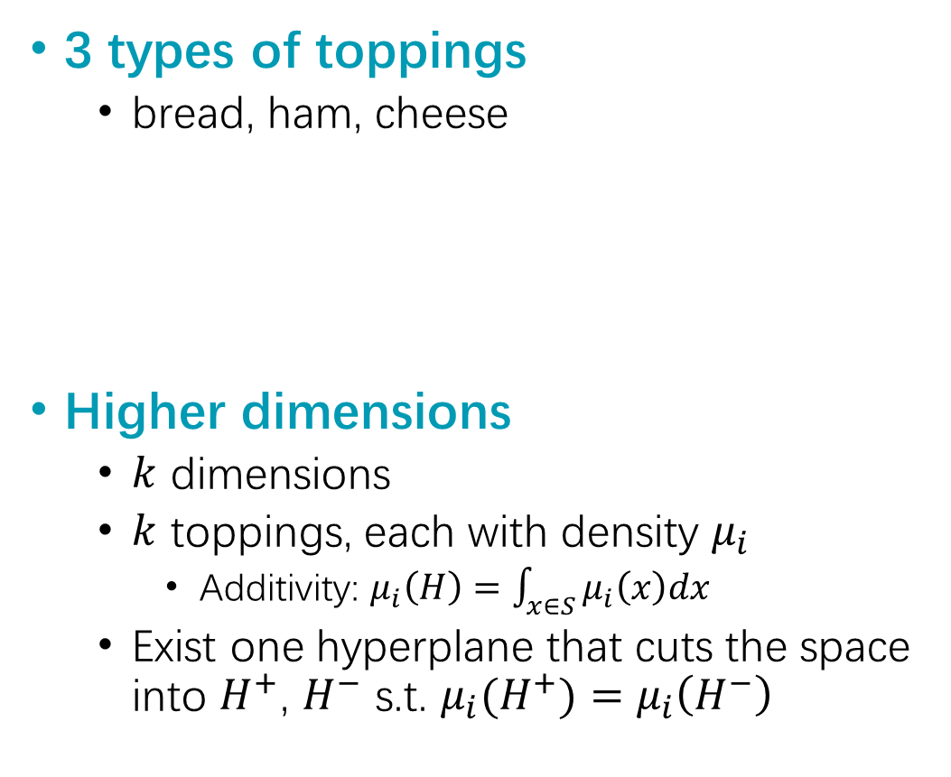
Ham Sandwich Theorem
3 types of toppings
bread, ham, cheese
Higher dimensions
$k$ dimensions
$k$ toppings, each with density $μ_{i}$
Additivity: $μ_{i}\left(H\right)=\int_{x∈S}{μ_{i}\left(x\right)dx}$
Exist one hyperplane that cuts the space into $H^{+}$, $H^{−}$ s.t. $μ_{i}(H^{+})=μ_{i}\left(H^{−}\right)$
Theorem. There exists a cut that equally partitions all three toppings

Slide 5
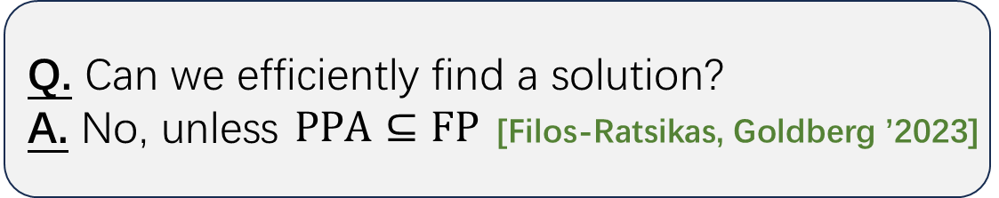
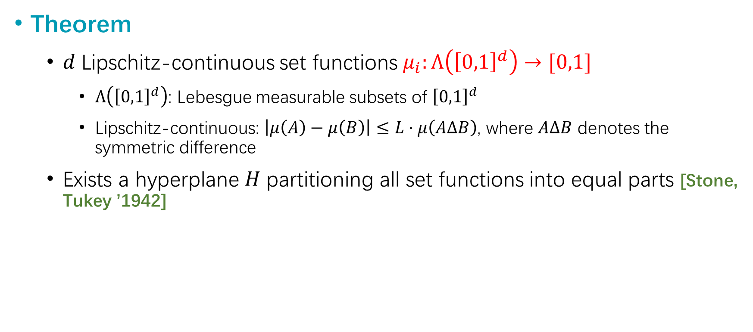
Generalized Ham Sandwich Theorem
Theorem
𝑑 Lipschitz-continuous set functions $μ_{i}:Λ\left({\left[0,1\right]}^{d}\right)→[0,1]$
$Λ\left({\left[0,1\right]}^{d}\right)$: Lebesgue measurable subsets of ${\left[0,1\right]}^{d}$
Lipschitz-continuous: $\left|μ\left(A\right)−μ\left(B\right)\right|≤L⋅μ\left(AΔB\right)$, where $AΔB$ denotes the symmetric difference
Exists a hyperplane 𝐻 partitioning all set functions into equal parts [Stone, Tukey ’1942]
Q. Can we efficiently find a solution?
A. No, unless $PPA⊆FP$ [Filos-Ratsikas, Goldberg ’2023]

Slide 6
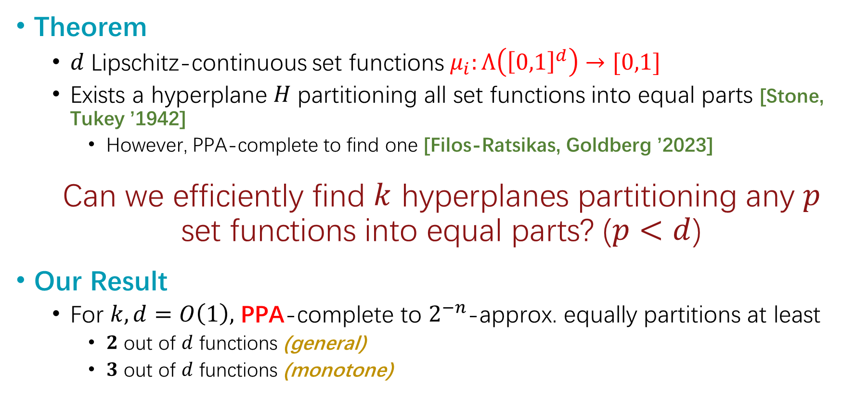
Generalized Ham Sandwich - cont’d
Theorem
𝑑 Lipschitz-continuous set functions $μ_{i}:Λ\left({\left[0,1\right]}^{d}\right)→[0,1]$
Exists a hyperplane 𝐻 partitioning all set functions into equal parts [Stone, Tukey ’1942]
However, PPA-complete to find one [Filos-Ratsikas, Goldberg ’2023]
Can we efficiently find $k$ hyperplanes partitioning any $p$ set functions into equal parts? ($p<d$)
Our Result
For $k,d=O\left(1\right),$ PPA-complete to $2^{−n}$-approx. equally partitions at least
$2$ out of $d$ functions (general)
$3$ out of $d$ functions (monotone)

Slide 7
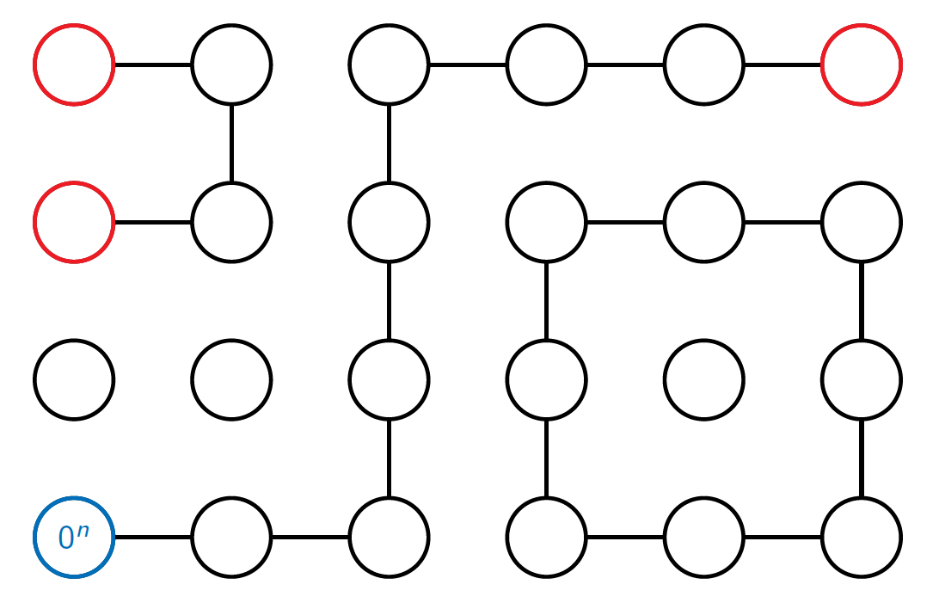
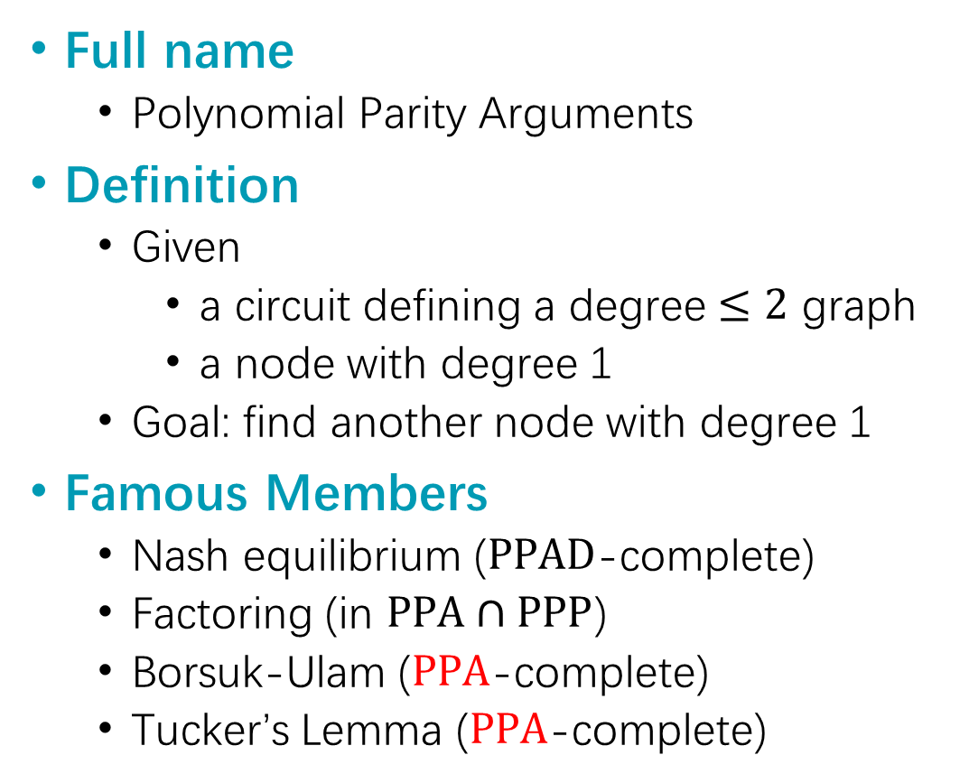
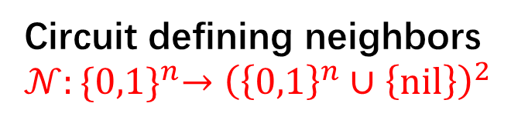
PPA
Full name
Polynomial Parity Arguments
Definition
Given
a circuit defining a degree $≤2$ graph
a node with degree 1
Goal: find another node with degree 1
Famous Members
Nash equilibrium ($PPAD$-complete)
Factoring (in $PPA∩PPP$)
Borsuk-Ulam ($PPA$-complete)
Tucker’s Lemma ($PPA$-complete)
Circuit defining neighbors
$𝒩:{\{0,1\}}^{n}→{\left({\left\{0,1\right\}}^{n}∪\left\{nil\right\}\right)}^{2}$

Slide 8
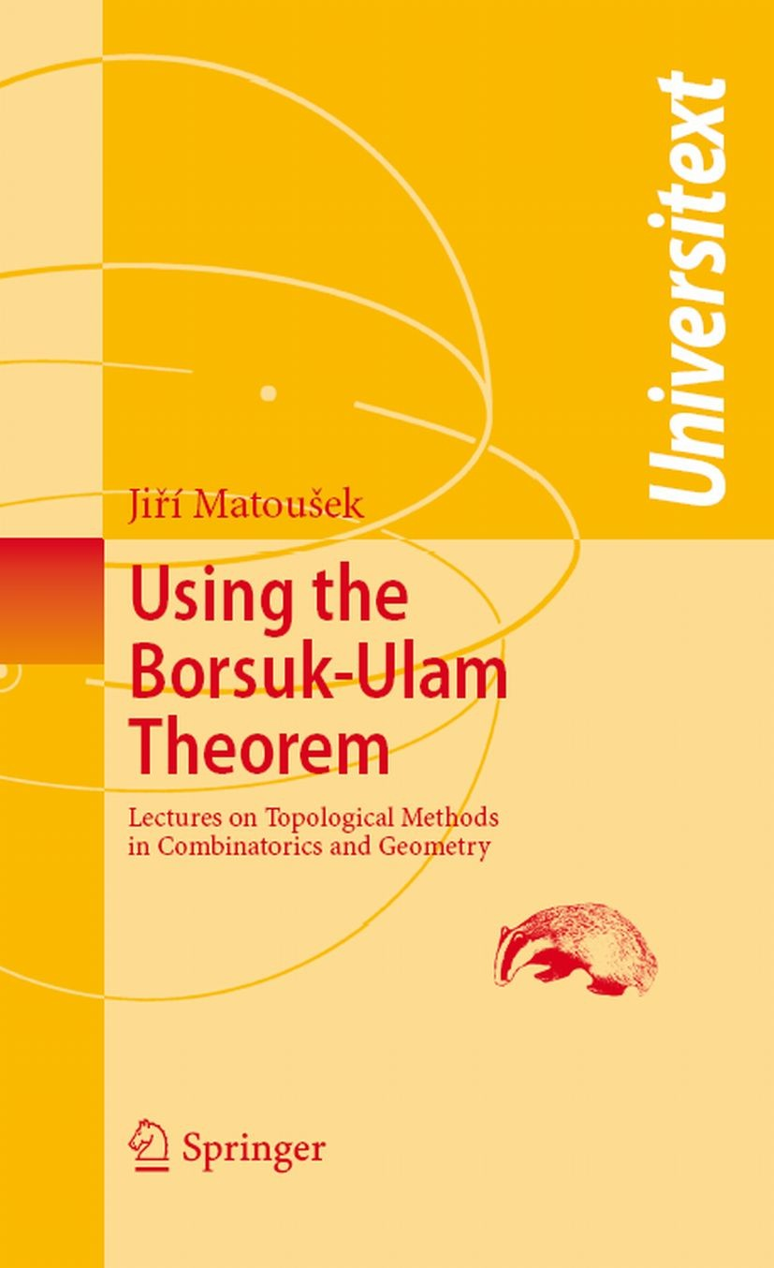


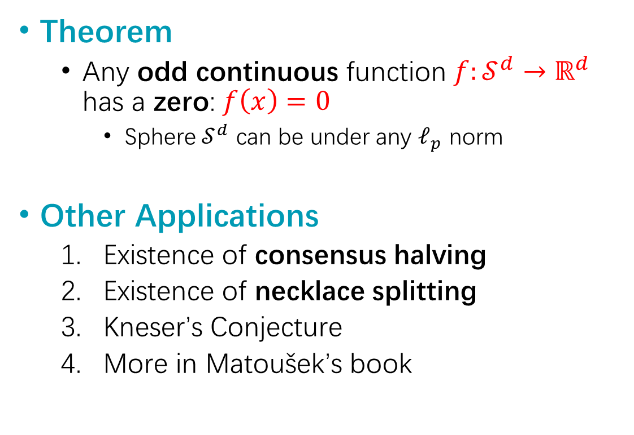
Borsuk-Ulam Theorem
Theorem
Any odd continuous function $f:𝒮^{d}→ℝ^{d}$ has a zero: $f\left(x\right)=0$
Sphere $𝒮^{d}$ can be under any $ℓ_{p}$ norm
Other Applications
Existence of consensus halving
Existence of necklace splitting
Kneser’s Conjecture
More in Matoušek’s book

Slide 9
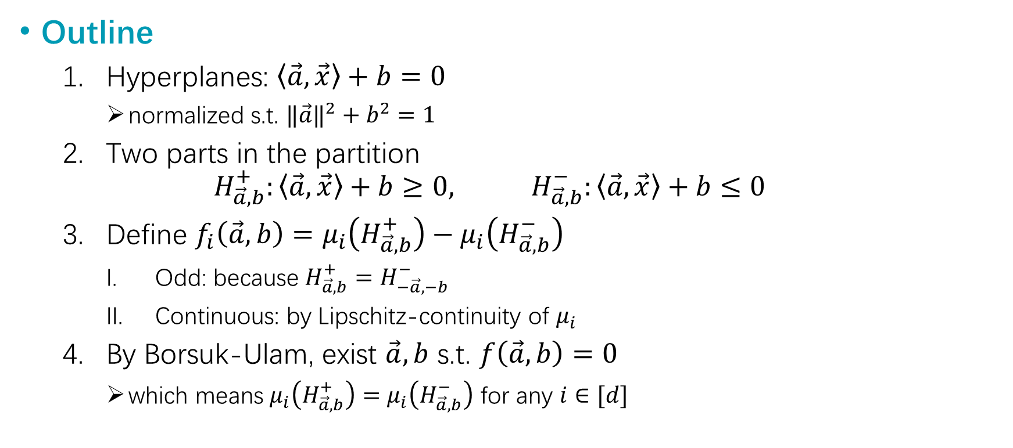
Borsuk Ulam → Ham Sandwich
Outline
Hyperplanes: $\left\langle \vec{a},\vec{x}\right\rangle +b=0$
normalized s.t. ${‖\vec{a}‖}^{2}+b^{2}=1$
Two parts in the partition
$$H_{\vec{a},b}^{+}:\left\langle \vec{a},\vec{x}\right\rangle +b≥0, H_{\vec{a},b}^{−}:\left\langle \vec{a},\vec{x}\right\rangle +b≤0$$
Define $f_{i}\left(\vec{a},b\right)=μ_{i}\left(H_{\vec{a},b}^{+}\right)−μ_{i}\left(H_{\vec{a},b}^{−}\right)$
Odd: because $H_{\vec{a},b}^{+}=H_{−\vec{a},−b}^{−}$
Continuous: by Lipschitz-continuity of $μ_{i}$
By Borsuk-Ulam, exist $\vec{a},b$ s.t. $f\left(\vec{a},b\right)=0$
which means $μ_{i}\left(H_{\vec{a},b}^{+}\right)=μ_{i}\left(H_{\vec{a},b}^{−}\right)$ for any $i∈[d]$

Slide 10
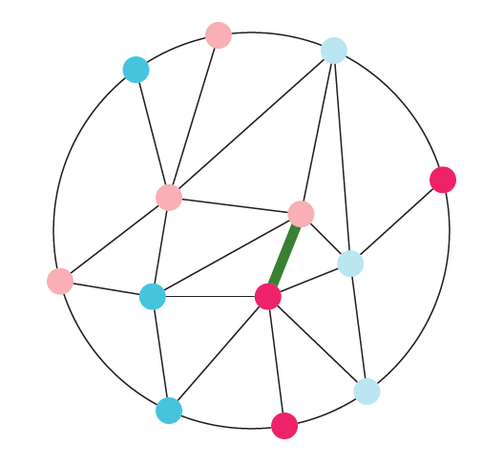
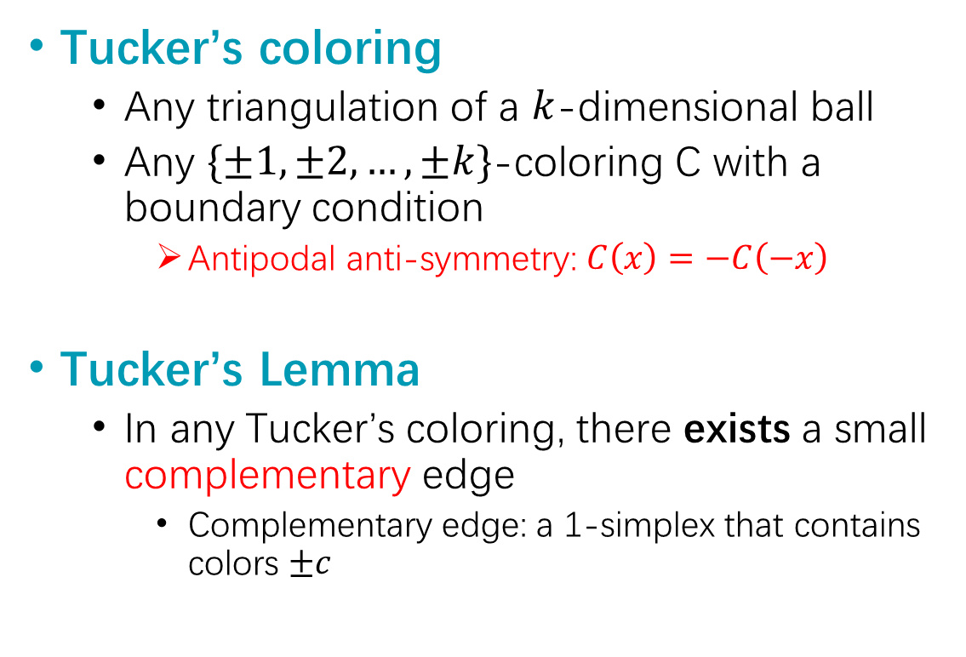
Tucker’s Lemma
Tucker’s coloring
Any triangulation of a $k$-dimensional ball
Any $\{±1,±2,…,±k\}$-coloring C with a boundary condition
Antipodal anti-symmetry: $C\left(x\right)=−C\left(−x\right)$
Tucker’s Lemma
In any Tucker’s coloring, there exists a small complementary edge
Complementary edge: a 1-simplex that contains colors $±c$

Slide 11
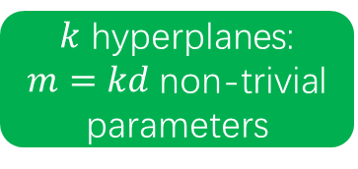
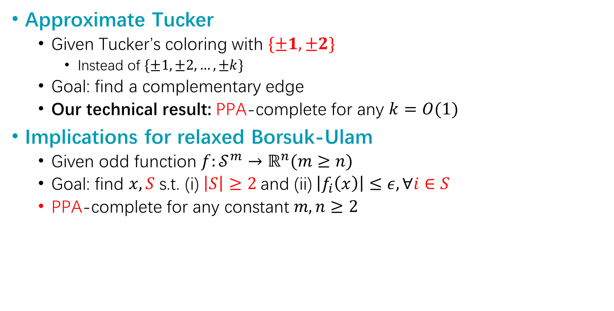
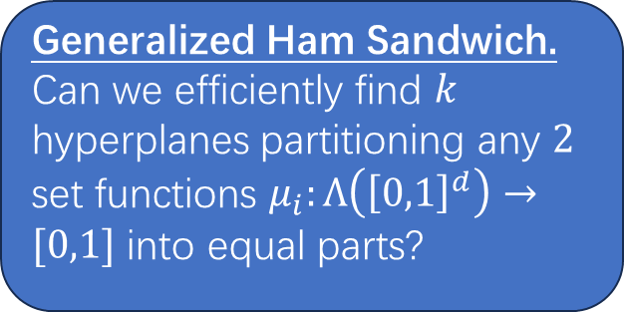
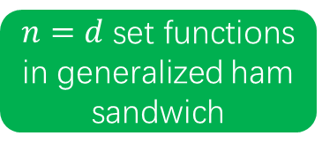
Approximate Tucker
Generalized Ham Sandwich.
Can we efficiently find $k$ hyperplanes partitioning any $2$ set functions $μ_{i}:Λ\left({\left[0,1\right]}^{d}\right)→[0,1]$ into equal parts?
Approximate Tucker
Given Tucker’s coloring with $\{±1,±2\}$
Instead of $\{±1,±2, …,±k\}$
Goal: find a complementary edge
Our technical result: PPA-complete for any $k=O(1)$
Implications for relaxed Borsuk-Ulam
Given odd function $f:𝒮^{m}→ℝ^{n}(m≥n)$
Goal: find $x,S$ s.t. (i)$\left|S\right|≥2$ and (ii) $\left|f_{i}\left(x\right)\right|≤ε, ∀i∈S$
PPA-complete for any constant $m,n≥2$
$k$ hyperplanes: $m=kd$ non-trivial parameters
$n=d$ set functions in generalized ham sandwich
# set functions equally partitioned

Slide 12
Techniques

Slide 13
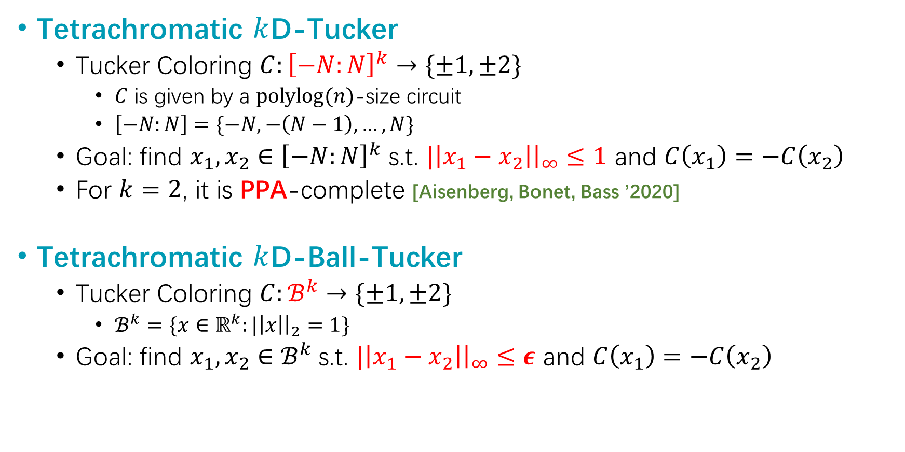
Formal Definitions
Tetrachromatic $k$D-Tucker
Tucker Coloring $C:{\left[−N:N\right]}^{k}→\{±1,±2\}$
$C$ is given by a $polylog(n)$-size circuit
$\left[−N:N\right]=\{−N,−\left(N−1\right),…,N\}$
Goal: find $x_{1},x_{2}∈{\left[−N:N\right]}^{k}$ s.t. $|\left|x_{1}−x_{2}\right|{\left.​\right|}_{∞}≤1$ and $C\left(x_{1}\right)=−C\left(x_{2}\right)$
For $k=2$, it is PPA-complete [Aisenberg, Bonet, Bass ’2020]
Tetrachromatic $k$D-Ball-Tucker
Tucker Coloring $C:ℬ^{k}→\{±1,±2\}$
$ℬ^{k}=\{x∈ℝ^{k}:|\left|x\right|{\left.​\right|}_{2}=1\}$
Goal: find $x_{1},x_{2}∈ℬ^{k}$ s.t. $|\left|x_{1}−x_{2}\right|{\left.​\right|}_{∞}≤ε$ and $C\left(x_{1}\right)=−C\left(x_{2}\right)$

Slide 14
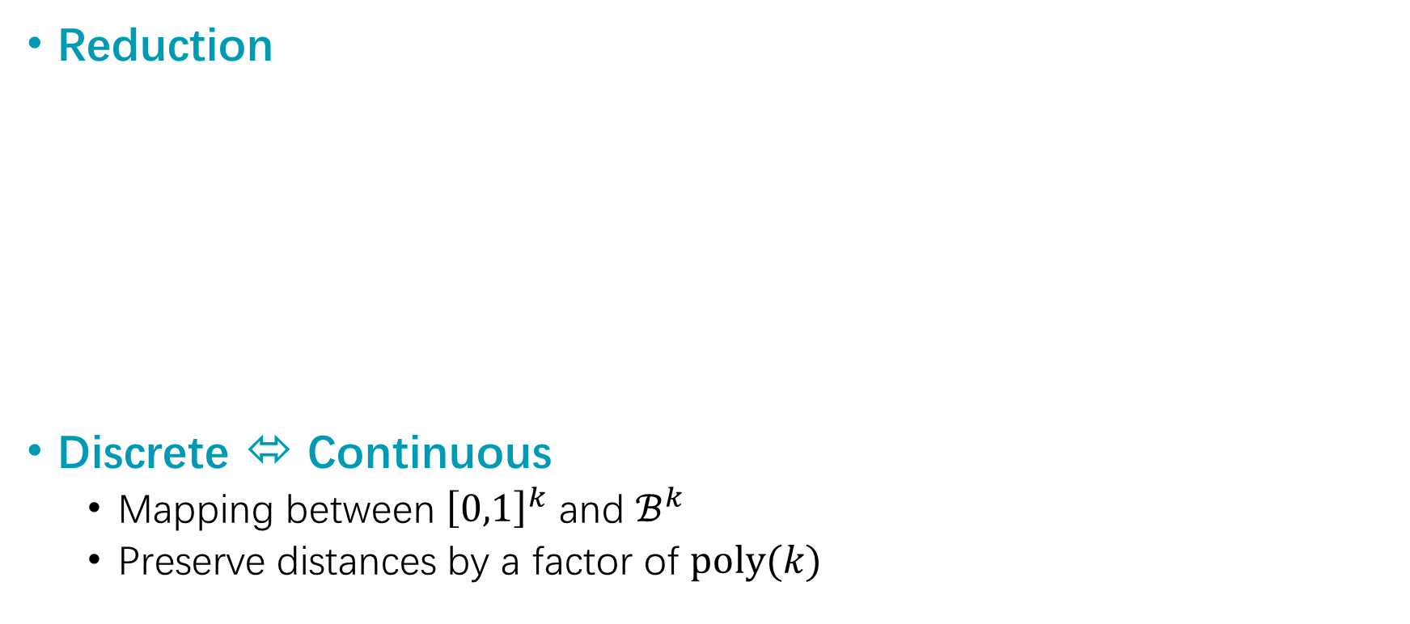

Overview
Reduction
Discrete ⬄ Continuous
Mapping between ${\left[0,1\right]}^{k}$ and $ℬ^{k}$
Preserve distances by a factor of $poly(k)$
$2$D-Tucker $≤_{p}$ 2D-Ball-Tucker
$≤_{p}$ Tetrachromatic $k$D-Ball-Tucker
$≤_{p}$ Tetrachromatic $k$D-Tucker

Slide 15
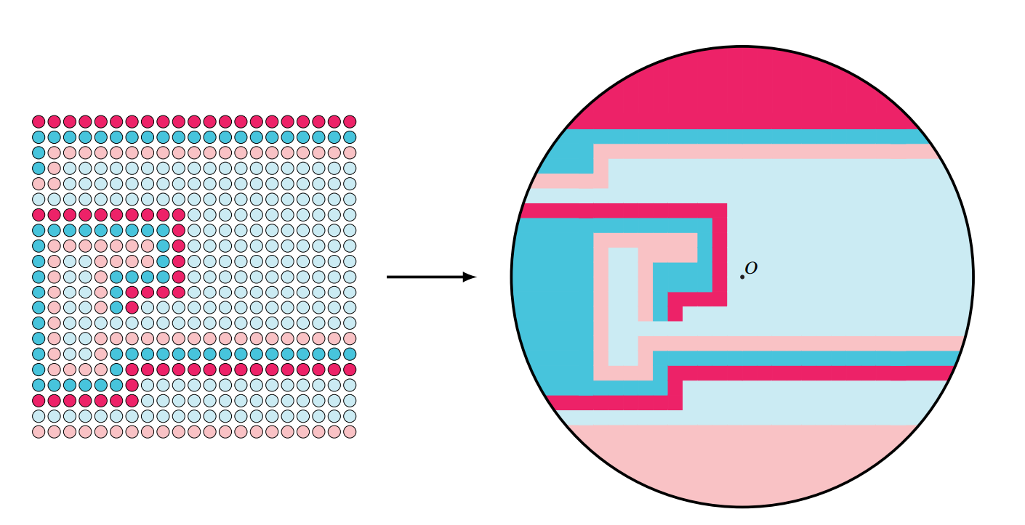
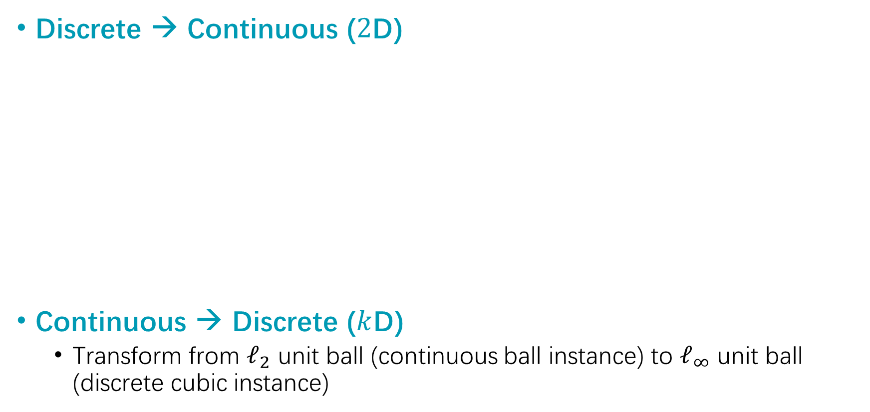
Discrete ⬄ Continuous
Discrete → Continuous ($2$D)
Continuous → Discrete ($k$D)
Transform from $ℓ_{2}$ unit ball (continuous ball instance) to $ℓ_{∞}$ unit ball (discrete cubic instance)

Slide 16
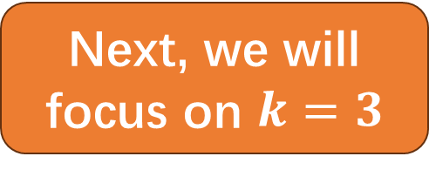
Overview
Reduction
$2$D-Tucker $≤_{p}$ 2D-Ball-Tucker
$≤_{p}$ Tetrachromatic $k$D-Ball-Tucker
$≤_{p}$ Tetrachromatic $k$D-Tucker
Next, we will focus on $k=3$

Slide 17
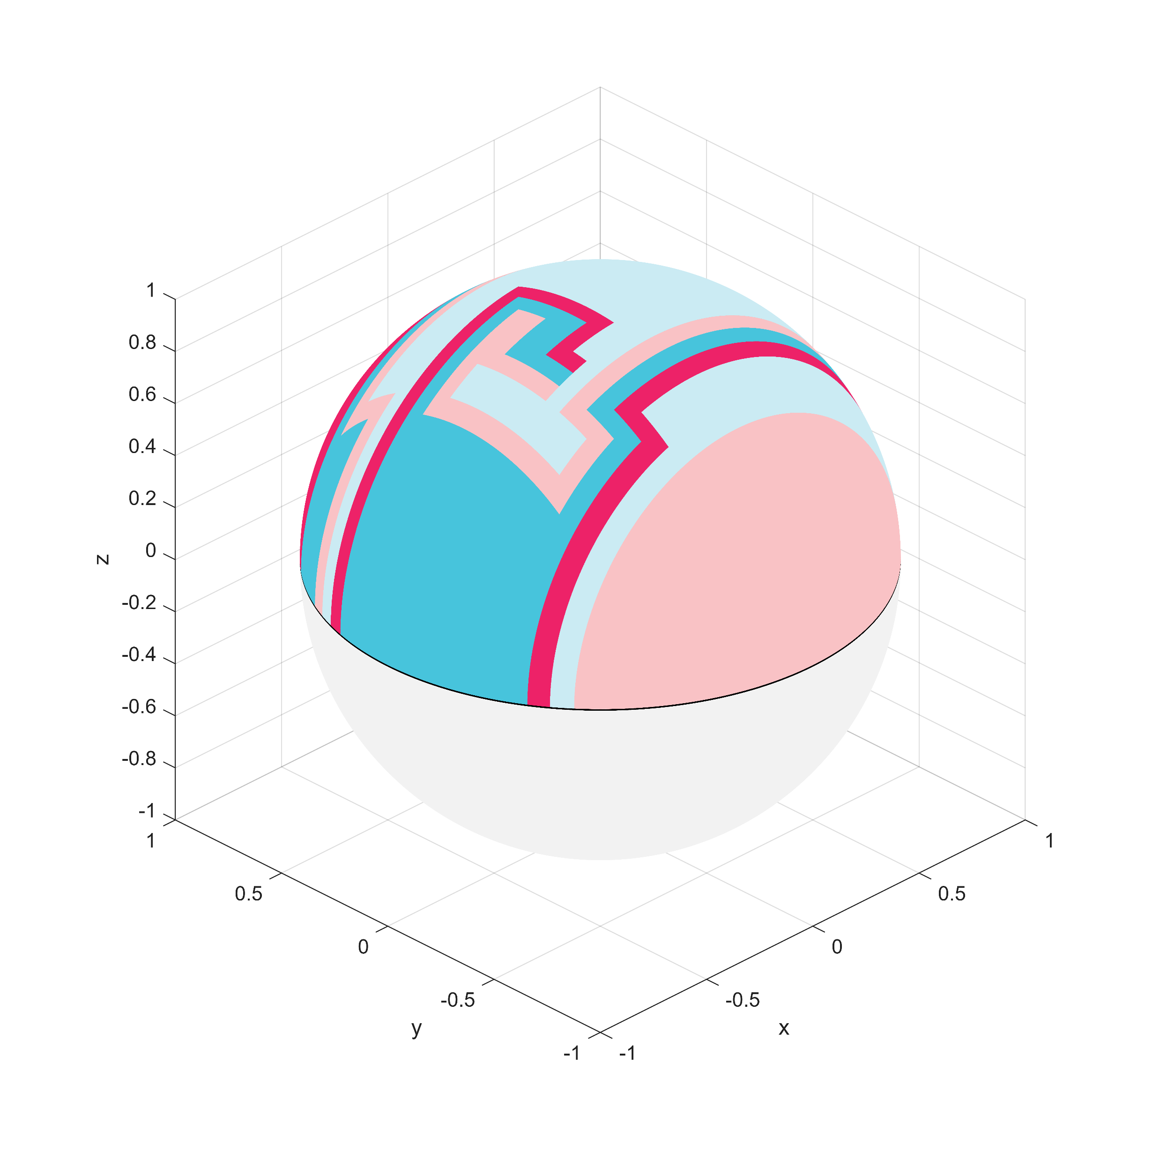
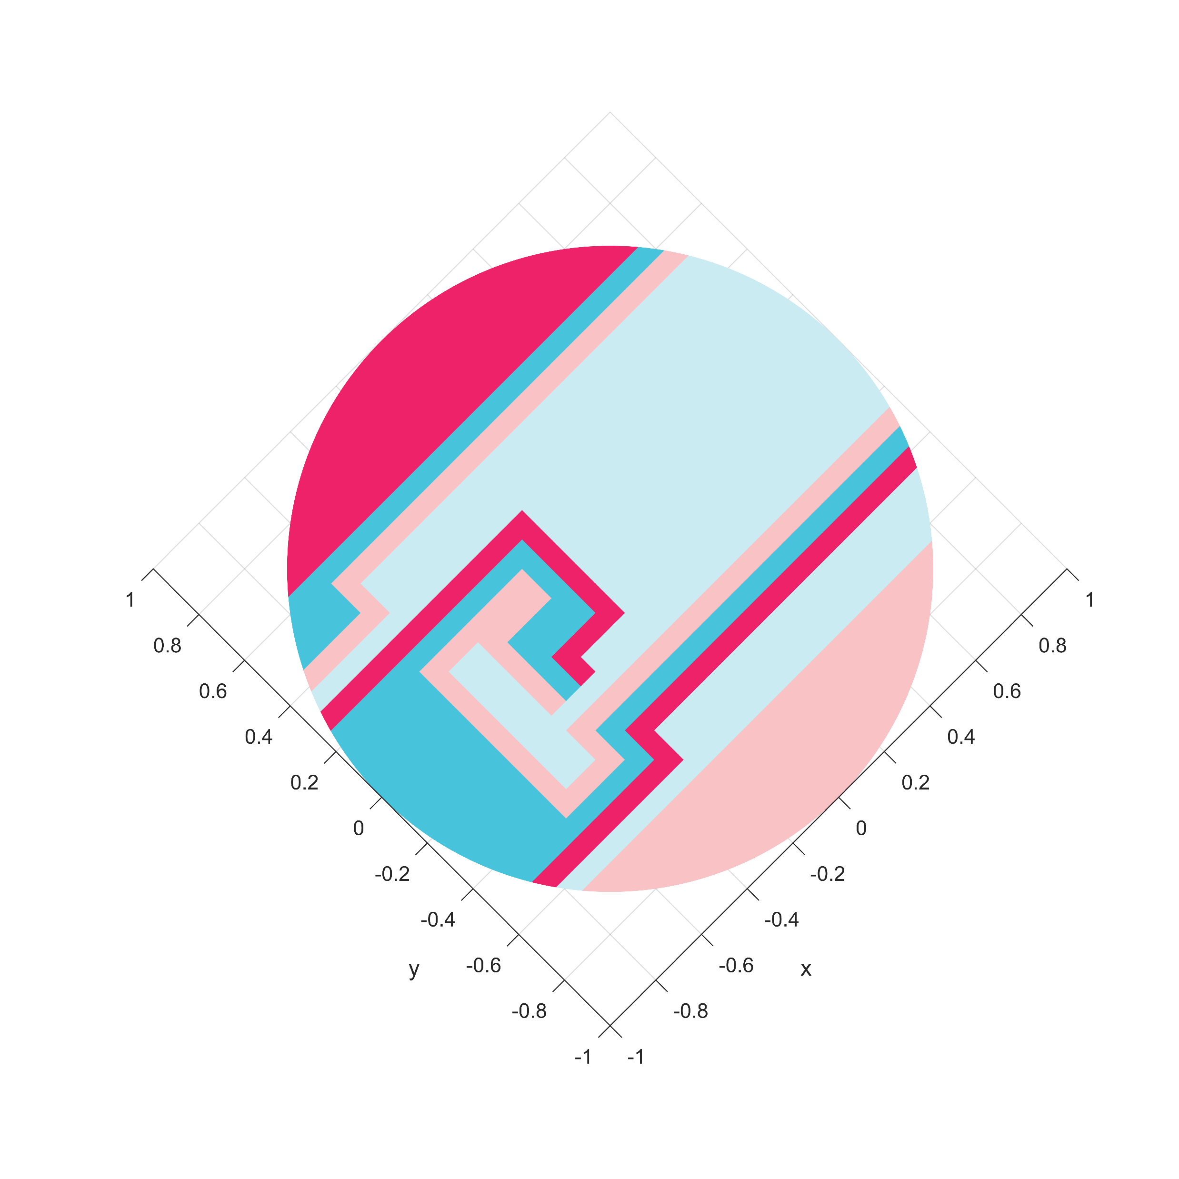
Step 1: Preliminary Sphere Coloring
Observation 1
Project upper/lower hemi-sphere to a circle → hard 2D instance

Slide 18
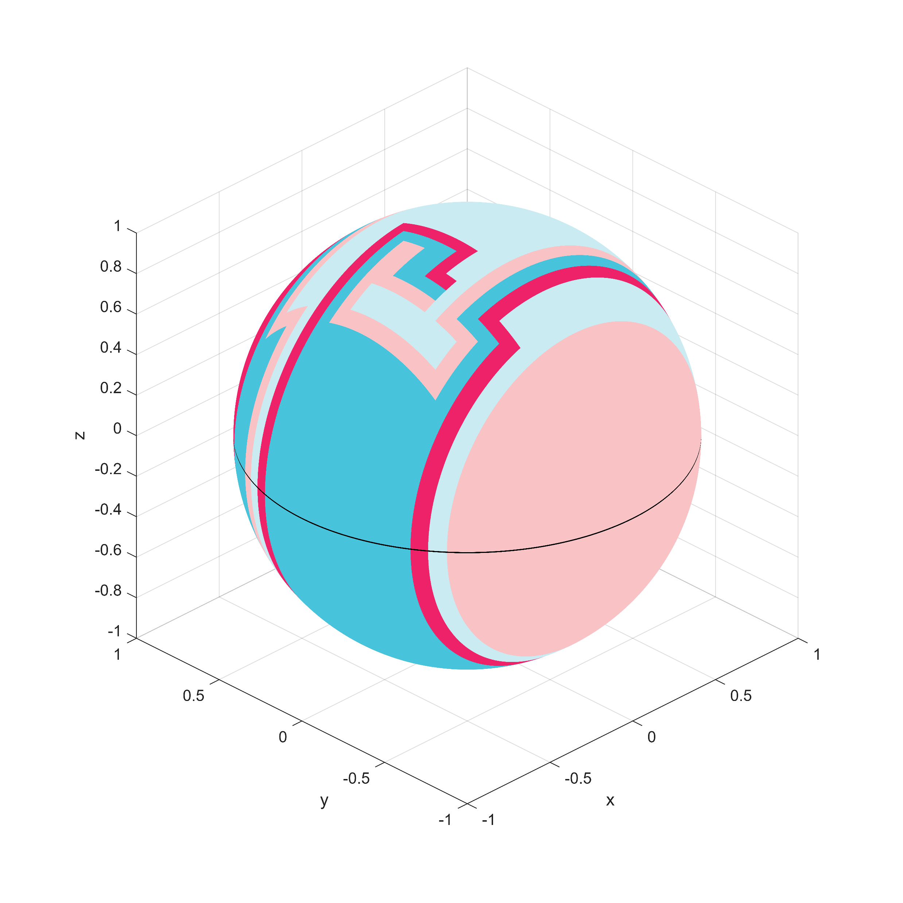
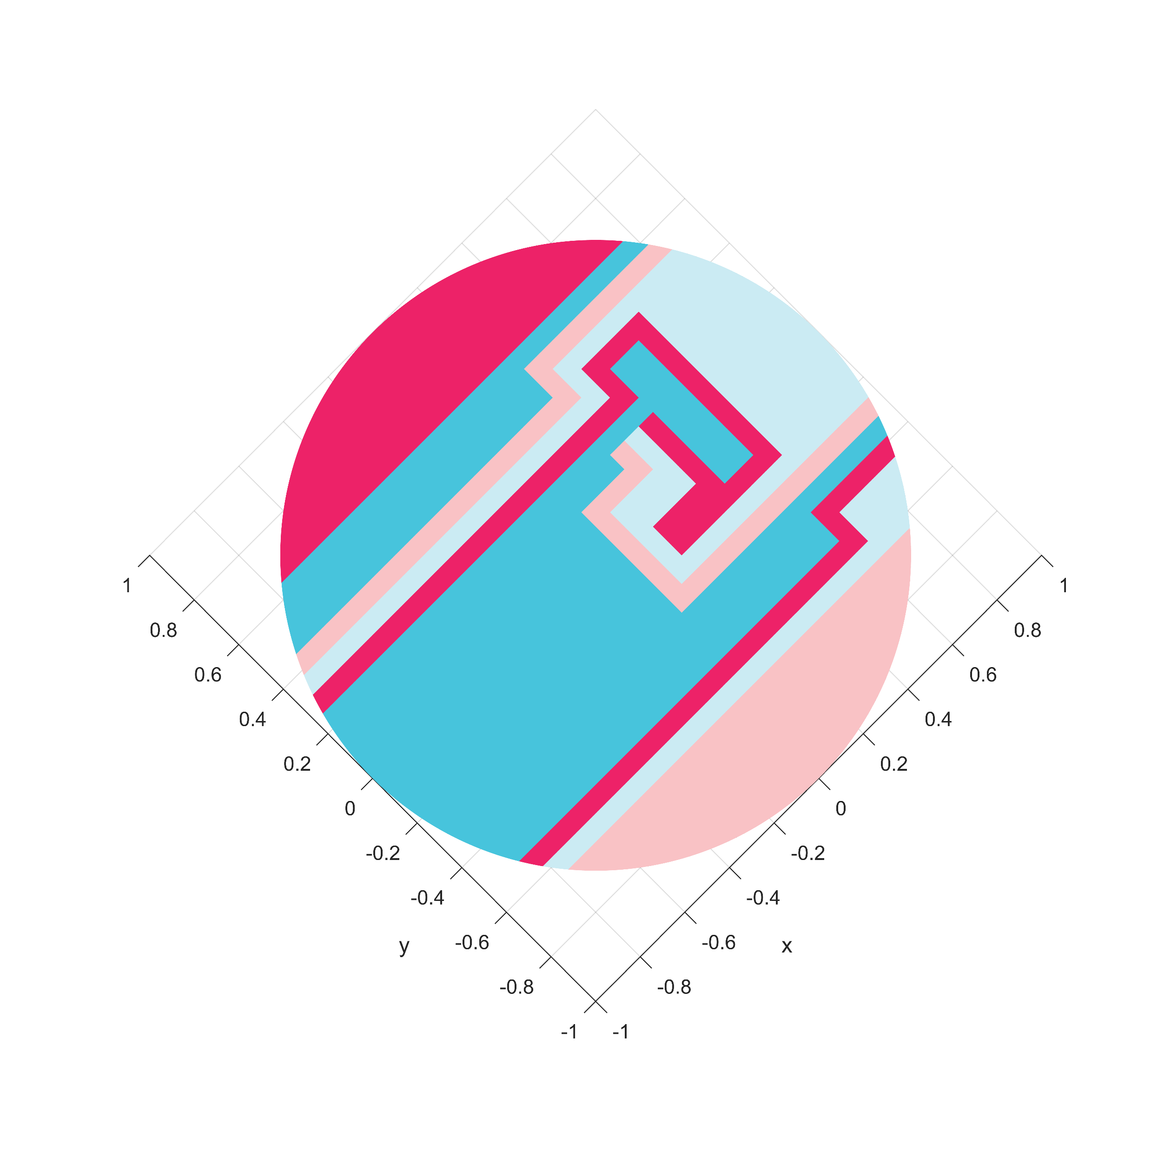
Step 1: Preliminary Sphere Coloring
Observation 2
Upper and lower hemi-sphere has the same boundary (on the equator)
Rotate
&
Negate

Slide 19
Step 1: Preliminary Sphere Coloring
PPA-hard to find a solution on the sphere
Rotate
&
Negate

Slide 20
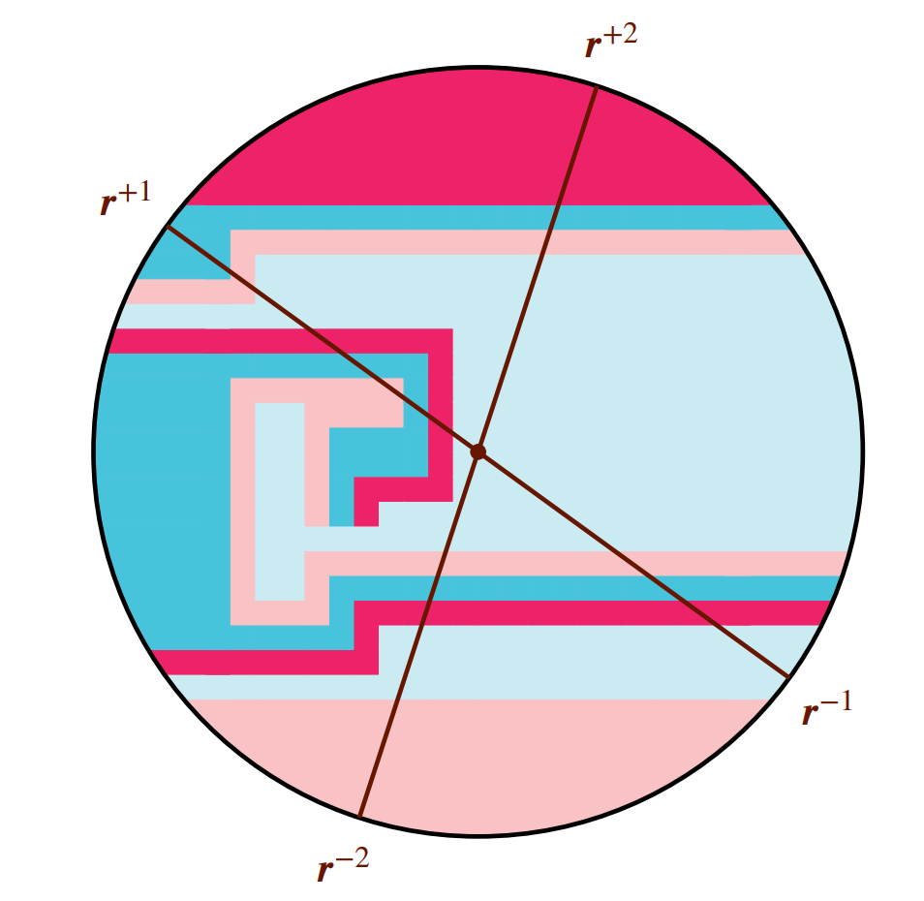
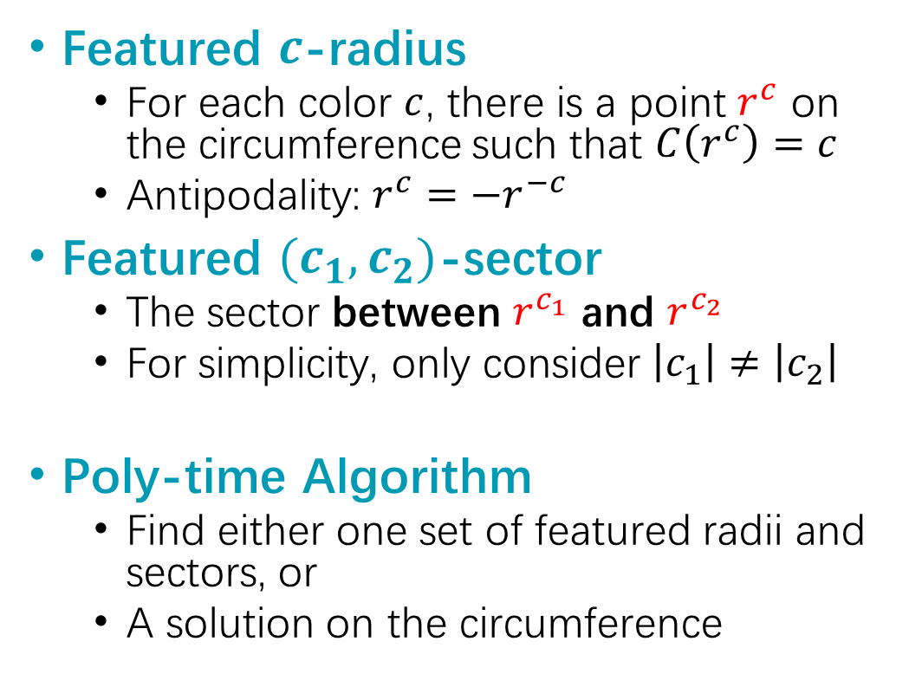
Step 2: Cut the 2D Instance
Featured $c$-radius
For each color $c$, there is a point $r^{c}$ on the circumference such that $C\left(r^{c}\right)=c$
Antipodality: $r^{c}=−r^{−c}$
Featured $(c_{1},c_{2})$-sector
The sector between $r^{c_{1}}$ and $r^{c_{2}}$
For simplicity, only consider $\left|c_{1}\right|≠\left|c_{2}\right|$
Poly-time Algorithm
Find either one set of featured radii and sectors, or
A solution on the circumference

Slide 21
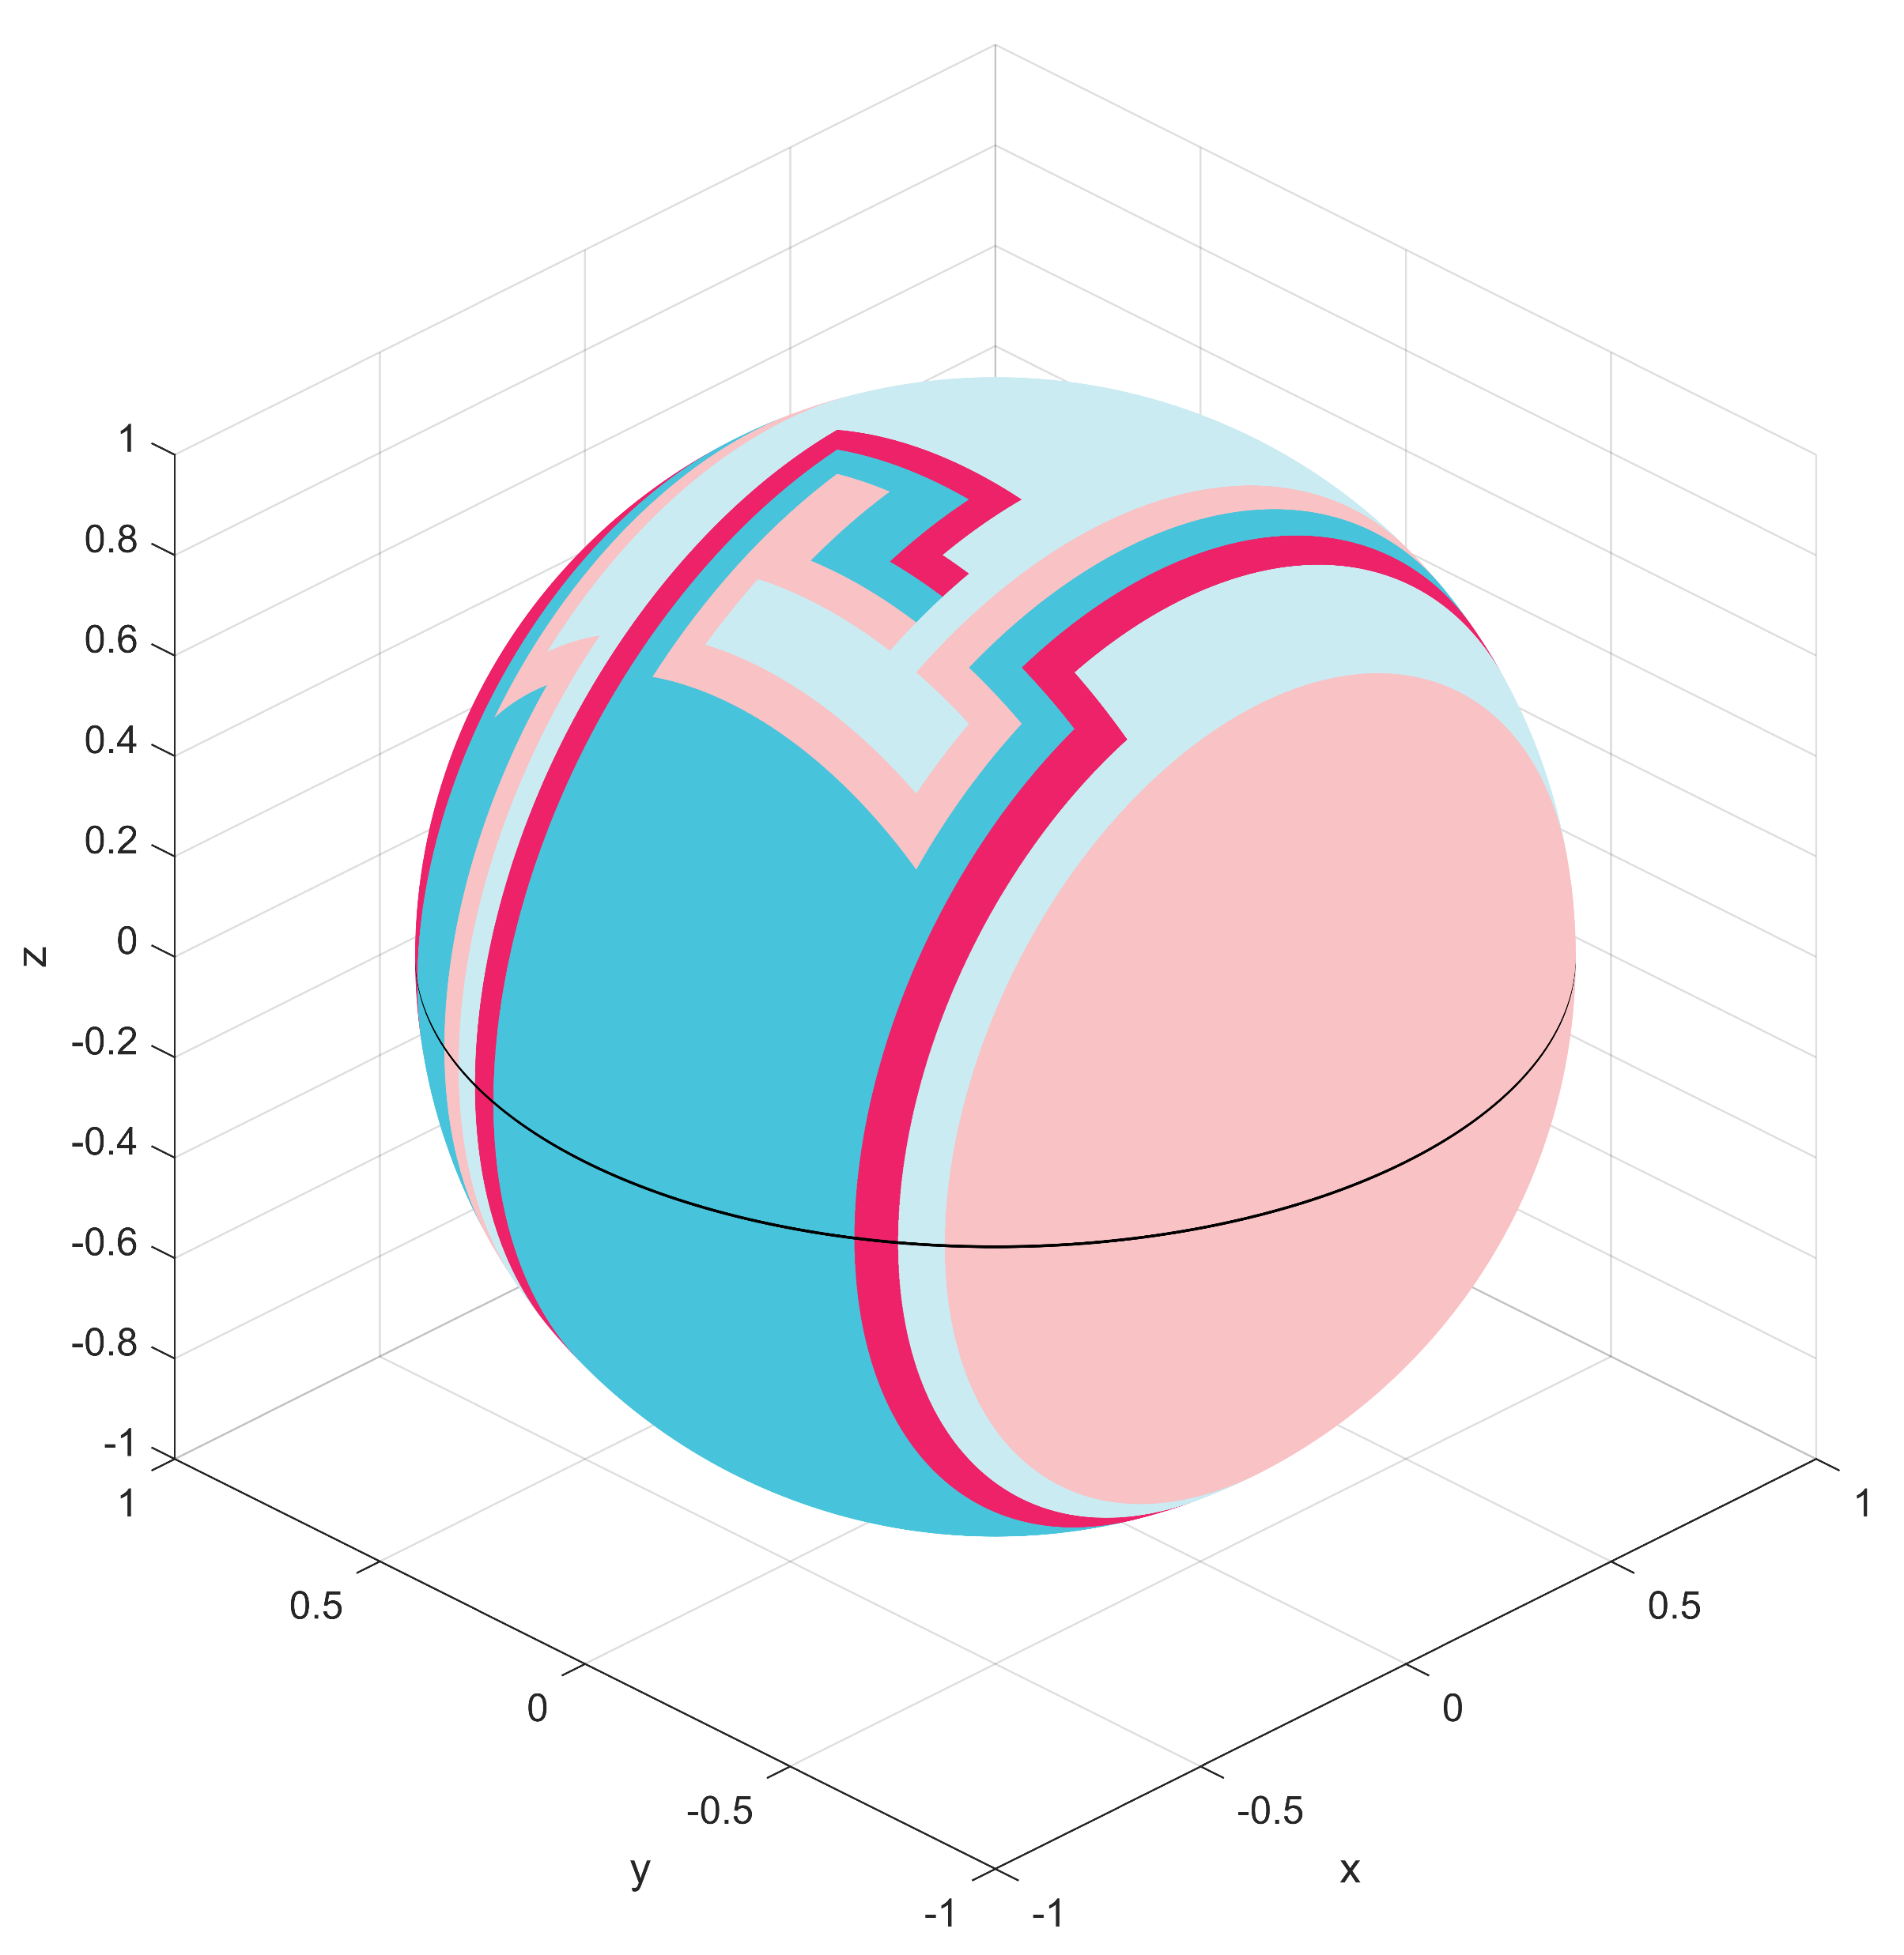
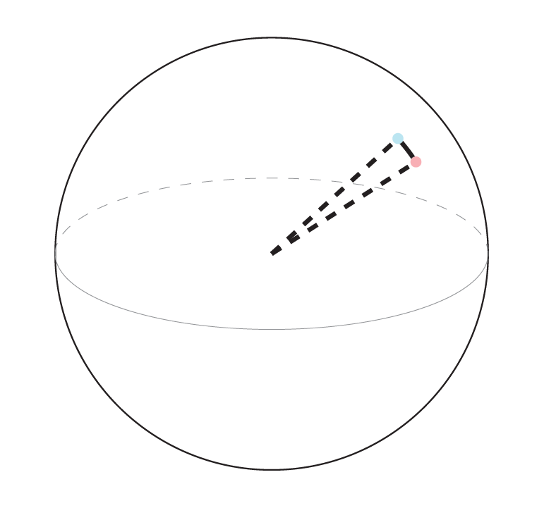
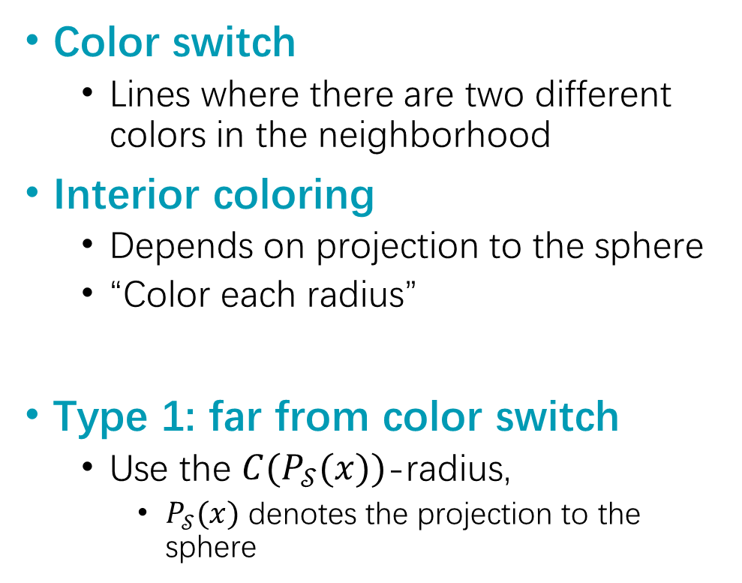
Step 3: Color the Interior
Color switch
Lines where there are two different colors in the neighborhood
Interior coloring
Depends on projection to the sphere
“Color each radius”
Type 1: far from color switch
Use the $C(P_{𝒮}(x))$-radius,
$P_{𝒮}(x)$ denotes the projection to the sphere
(-1,-2)-switch

Slide 22
Step 3: Color the Interior
Type 2: near color switch
Consider a small line perpendicular to the color switch
(-1,-2)-switch

Slide 23

Step 3: Color the Interior
Type 2: near color switch
Consider a small line perpendicular to the color switch
Consider the induced sector
Two points colored differently on the sphere
The center of the ball
Apply the featured sector to it
Sphere coloring modified along the line
Antipodal anti-symmetry is preserved
Type 2.5: two colors are opposite?
A solution on the sphere (PPA-hard)

Slide 24
PPAD & Other Related Problems

Slide 25
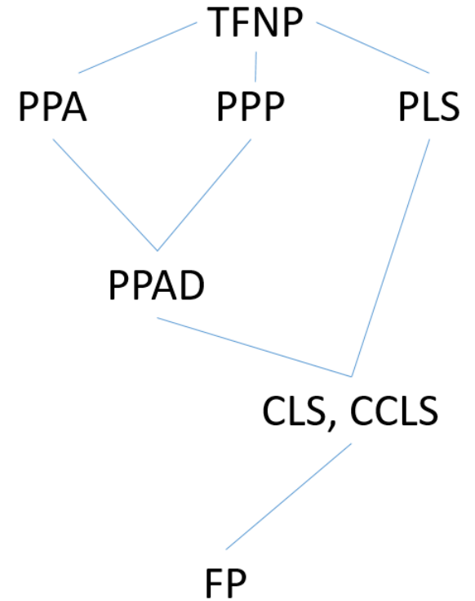
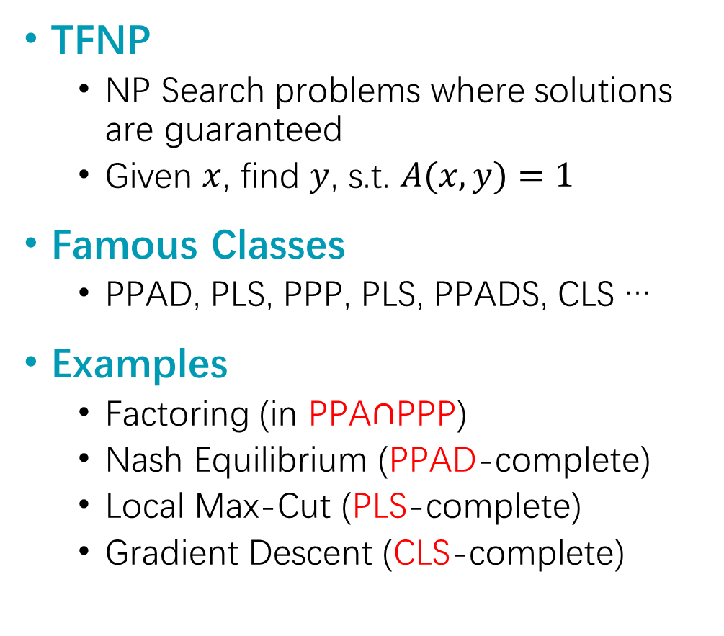
Total Search Problems
TFNP
NP Search problems where solutions are guaranteed
Given $x$, find $y$, s.t. $A(x,y)=1$
Famous Classes
PPAD, PLS, PPP, PLS, PPADS, CLS …
Examples
Factoring (in PPA$∩$PPP)
Nash Equilibrium (PPAD-complete)
Local Max-Cut (PLS-complete)
Gradient Descent (CLS-complete)

Slide 26
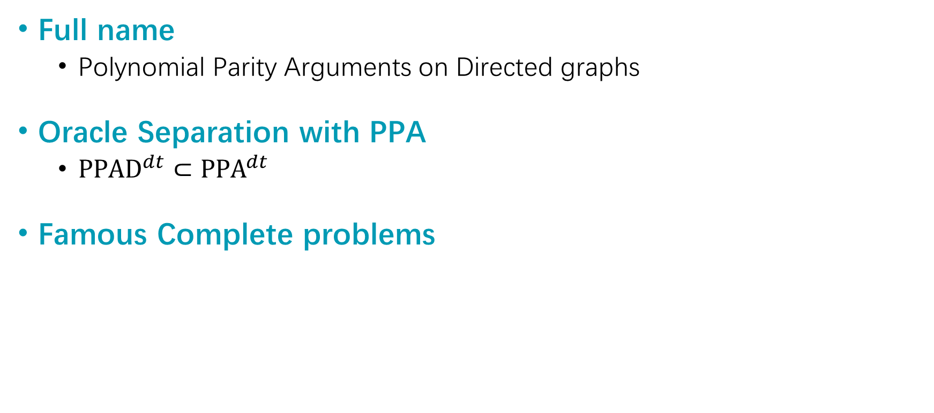
PPAD
Full name
Polynomial Parity Arguments on Directed graphs
Oracle Separation with PPA
${PPAD}^{dt}⊂{PPA}^{dt}$
Famous Complete problems
Nash Equilibrium
Arrow-Debreu Equilibrium
Brouwer’s Fixed Points
Sperner’s lemma
PPAD
Consensus Halving
Ham Sandwich
Borsuk-Ulam
Tucker’s lemma
PPA

Slide 27
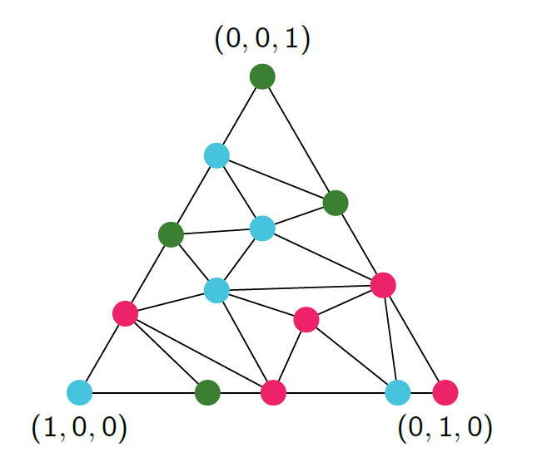
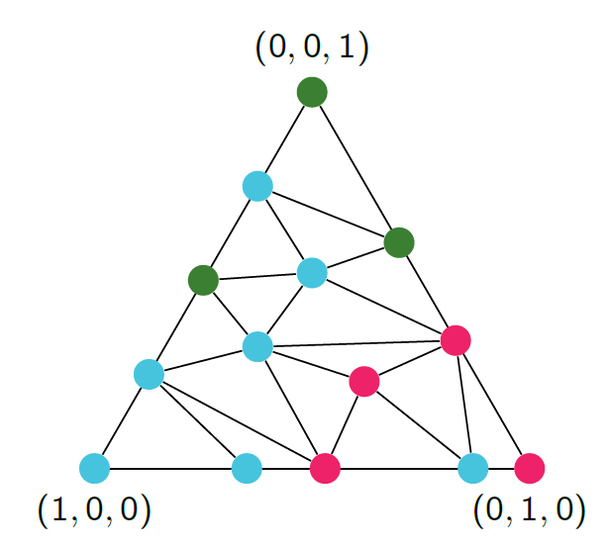
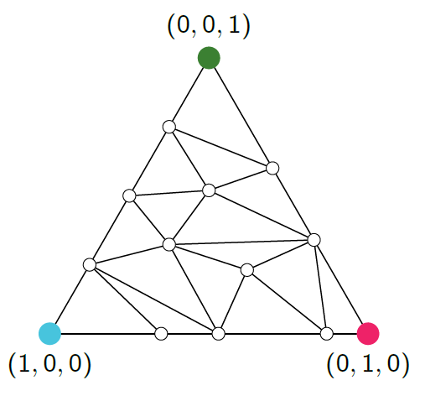
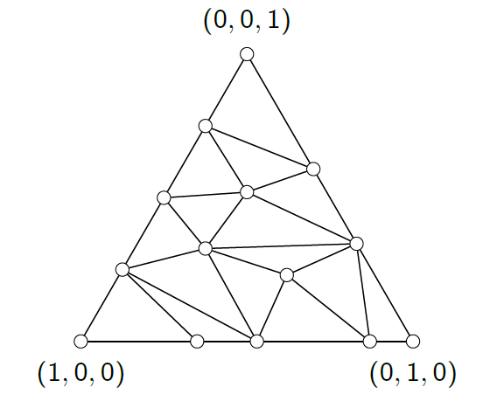


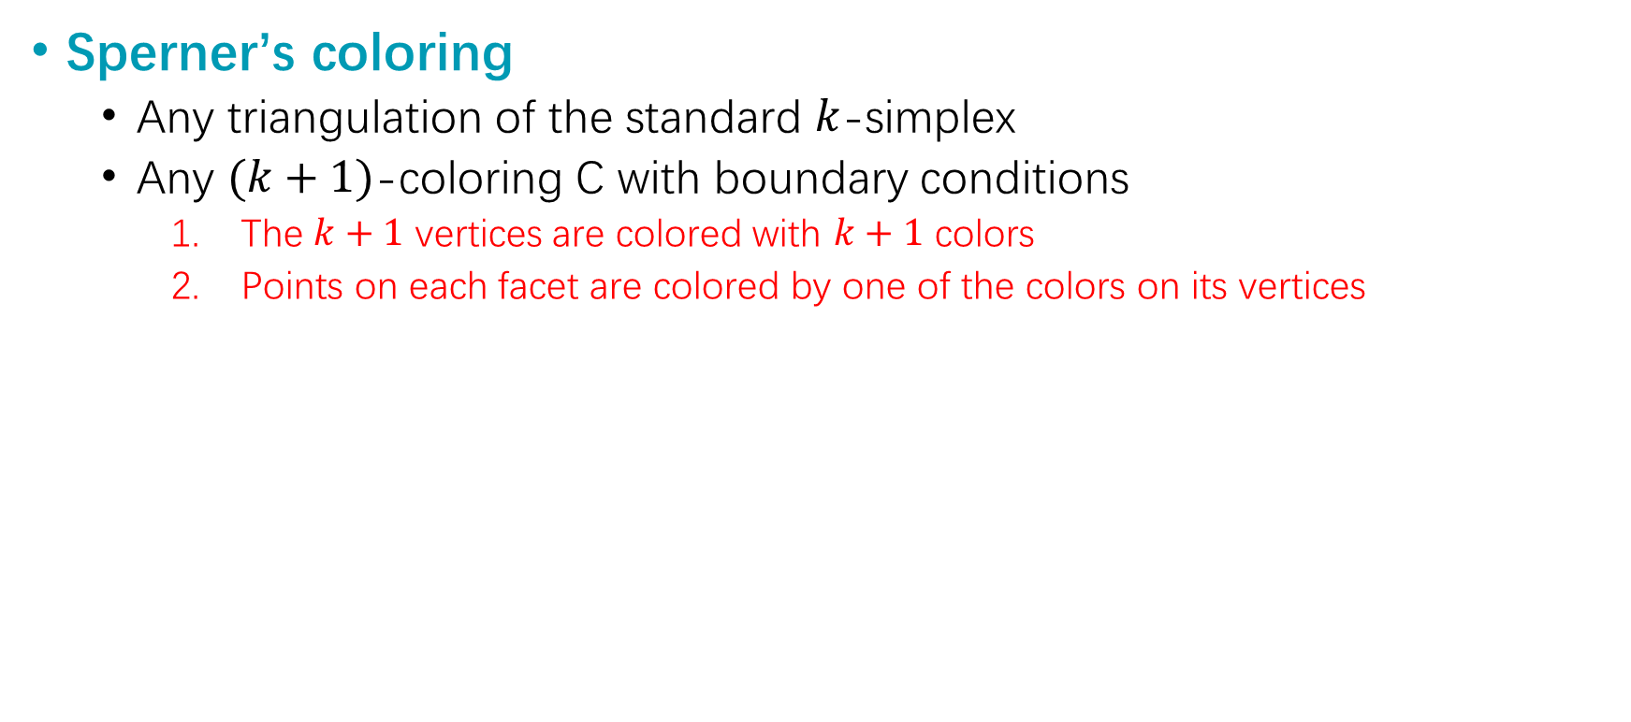
Sperner’s Lemma
Sperner’s coloring
Any triangulation of the standard $k$-simplex
Any $(k+1)$-coloring C with boundary conditions
The $k+1$ vertices are colored with $k+1$ colors
Points on each facet are colored by one of the colors on its vertices

Slide 28
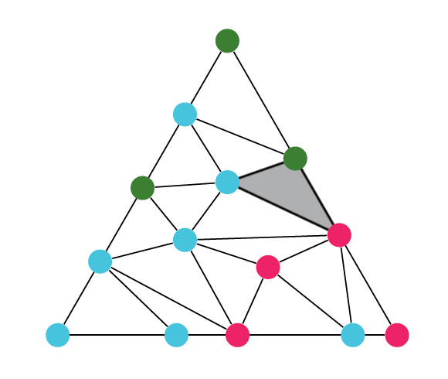
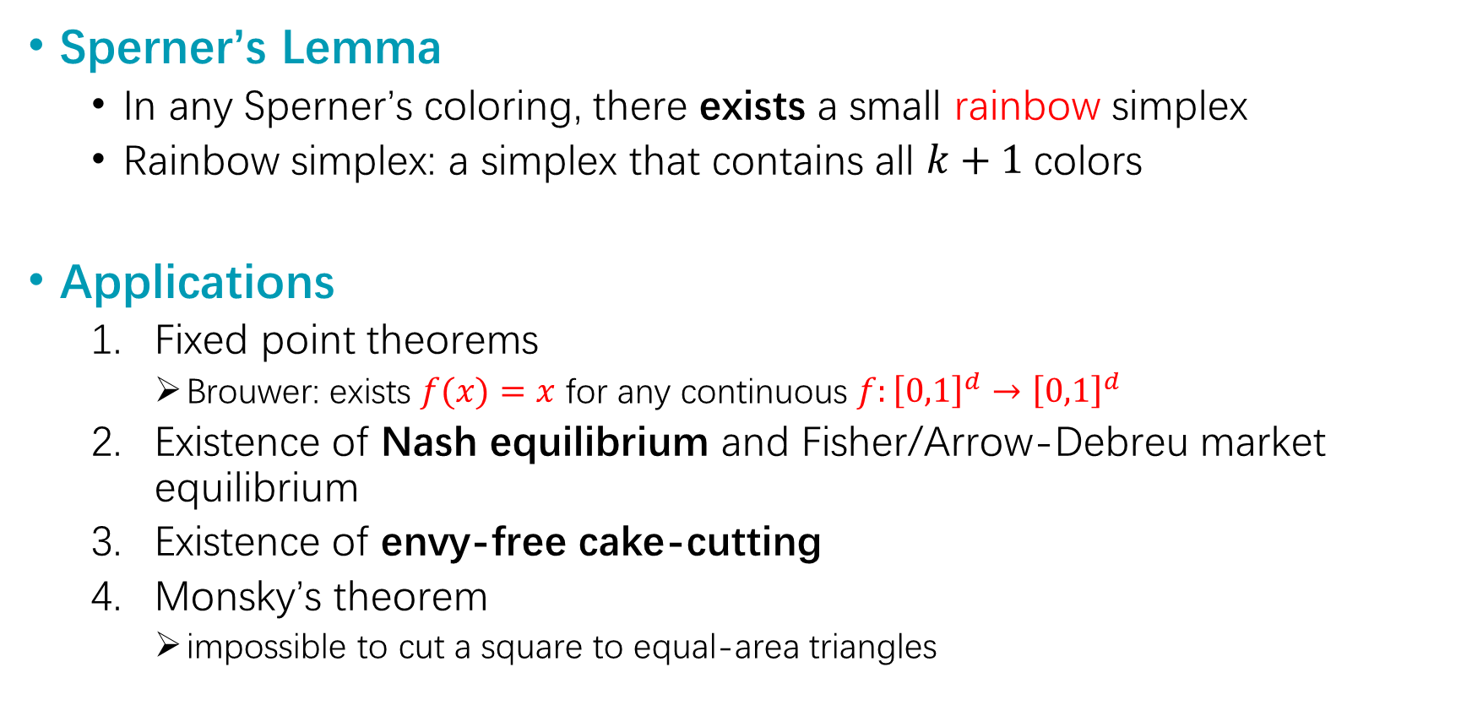
Sperner’s Lemma
Sperner’s Lemma
In any Sperner’s coloring, there exists a small rainbow simplex
Rainbow simplex: a simplex that contains all $k+1$colors
Applications
Fixed point theorems
Brouwer: exists $f(x)=x$ for any continuous $f:{\left[0,1\right]}^{d}→{\left[0,1\right]}^{d}$
Existence of Nash equilibrium and Fisher/Arrow-Debreu market equilibrium
Existence of envy-free cake-cutting
Monsky’s theorem
impossible to cut a square to equal-area triangles

Slide 29
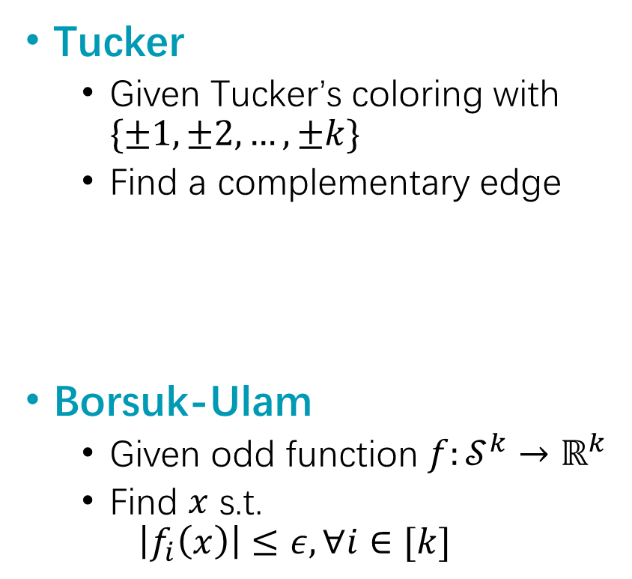
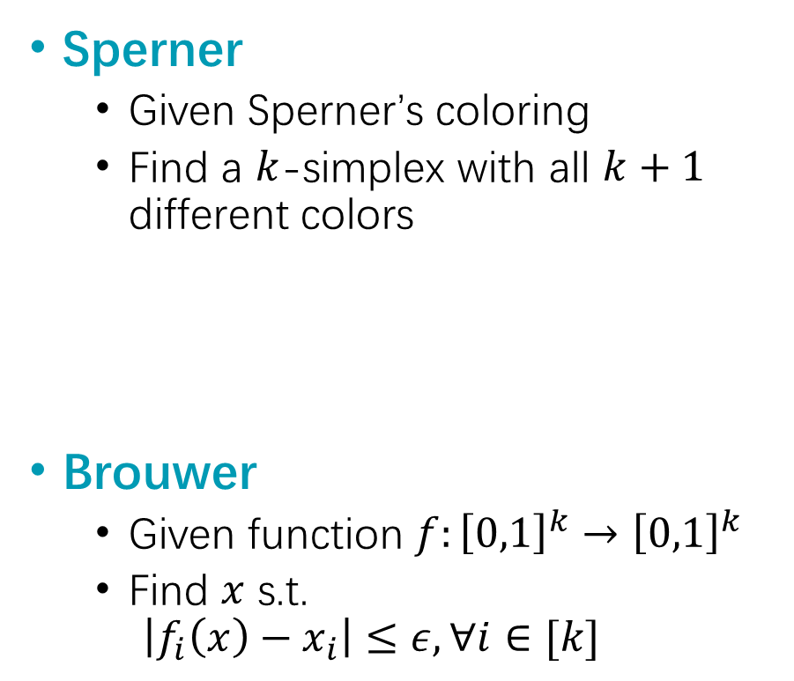
Complexity of Sperner / Tucker
Sperner
Given Sperner’s coloring
Find a $k$-simplex with all $k+1$ different colors
Brouwer
Given function $f:{\left[0,1\right]}^{k}→{\left[0,1\right]}^{k}$
Find $x$ s.t.
$$\left|f_{i}\left(x\right)−x_{i}\right|≤ε, ∀i∈[k]$$
Tucker
Given Tucker’s coloring with $\{±1,±2,…,±k\}$
Find a complementary edge
Borsuk-Ulam
Given odd function $f:𝒮^{k}→ℝ^{k}$
Find $x$ s.t.
$$\left|f_{i}\left(x\right)\right|≤ε, ∀i∈[k]$$
PPAD-complete
[Papadimitriou ’1994; Chen, Deng ’2009]
PPA-complete
[Aisenberg, Bonet, Bass ’2020]

Slide 30
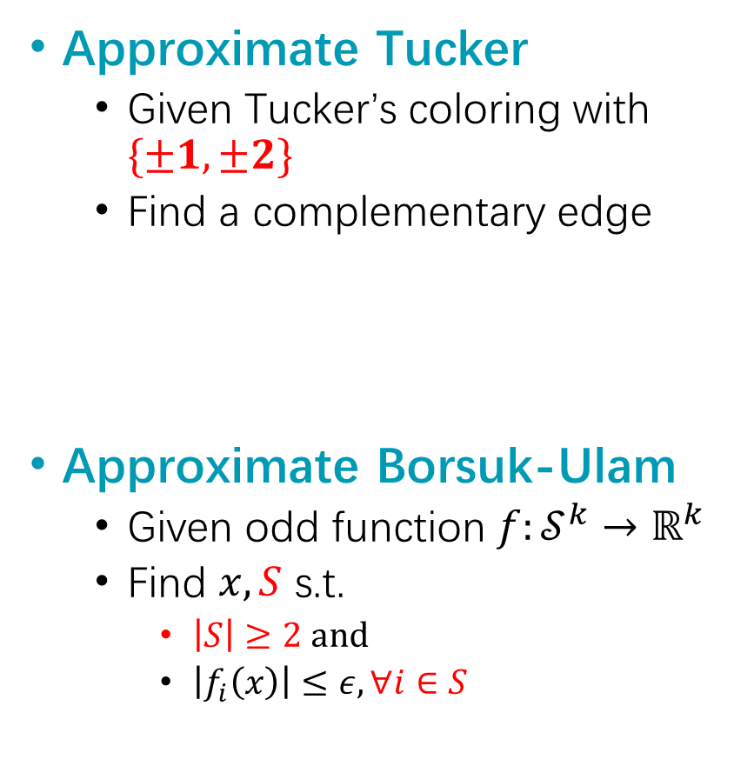
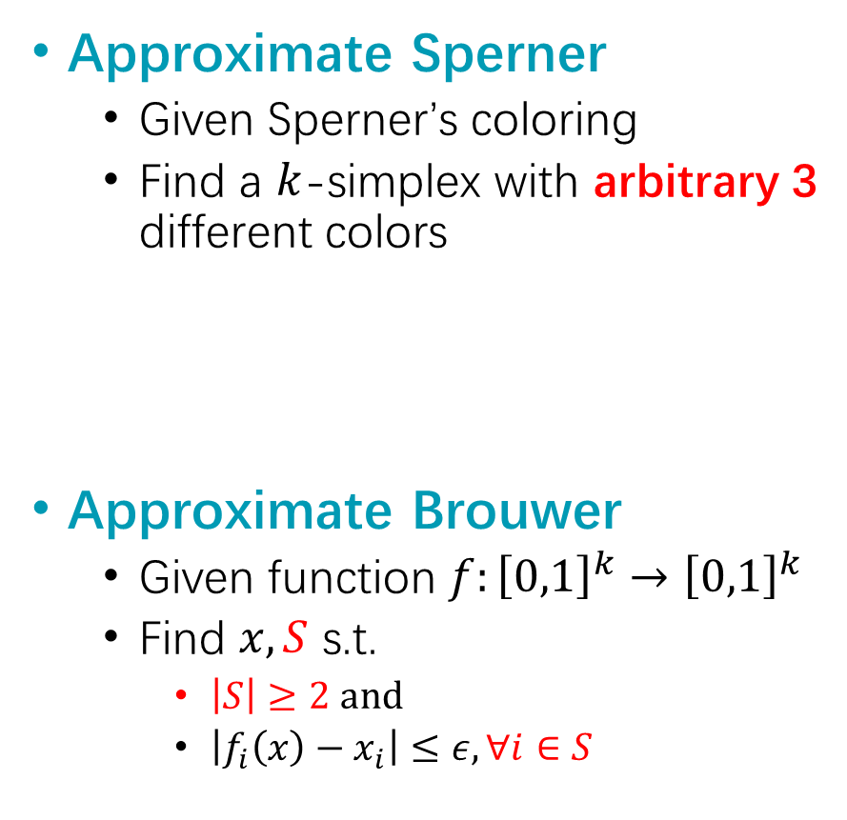
Approximate Sperner / Tucker
Approximate Sperner
Given Sperner’s coloring
Find a $k$-simplex with arbitrary 3 different colors
Approximate Brouwer
Given function $f:{\left[0,1\right]}^{k}→{\left[0,1\right]}^{k}$
Find $x,S$ s.t.
$\left|S\right|≥2$and
$\left|f_{i}\left(x\right)−x_{i}\right|≤ε, ∀i∈S$
Approximate Tucker
Given Tucker’s coloring with $\{±1,±2\}$
Find a complementary edge
Approximate Borsuk-Ulam
Given odd function $f:𝒮^{k}→ℝ^{k}$
Find $x,S$ s.t.
$\left|S\right|≥2$and
$\left|f_{i}\left(x\right)\right|≤ε, ∀i∈S$
PPAD-complete
(ours)
PPA-complete
(ours)

Slide 31
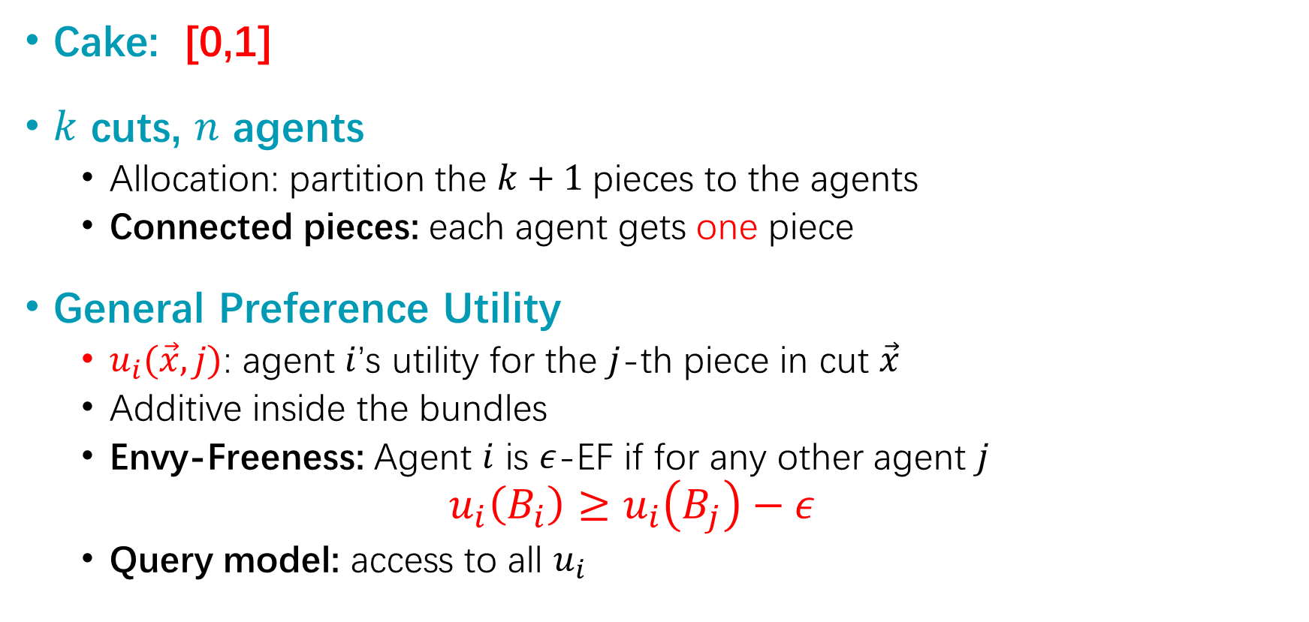
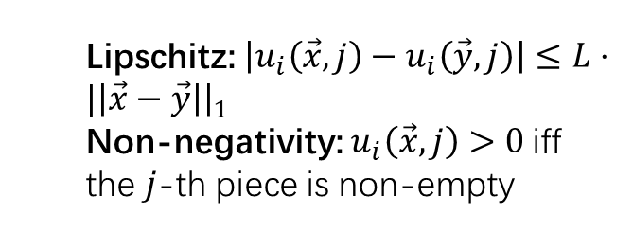
Application: Cake Cutting
Cake: [0,1]
$k$ cuts, $n$ agents
Allocation: partition the $k+1$pieces to the agents
Connected pieces: each agent gets one piece
General Preference Utility
$u_{i}(\vec{x},j)$: agent $i$’s utility for the $j$-th piece in cut $\vec{x}$
Additive inside the bundles
Envy-Freeness: Agent $i$ is $ε$-EF if for any other agent $j$
$$u_{i}\left(B_{i}\right)≥u_{i}\left(B_{j}\right)−ε$$
Query model: access to all $u_{i}$
Naturally, we consider the query complexity
Lipschitz: $\left|u_{i}\left(\vec{x},j\right)−u_{i}\left(\vec{y},j\right)\right|≤L⋅|\left|\vec{x}−\vec{y}\right|{\left.​\right|}_{1}$
Non-negativity: $u_{i}\left(\vec{x},j\right)>0$iff the $j$-th piece is non-empty

Slide 32
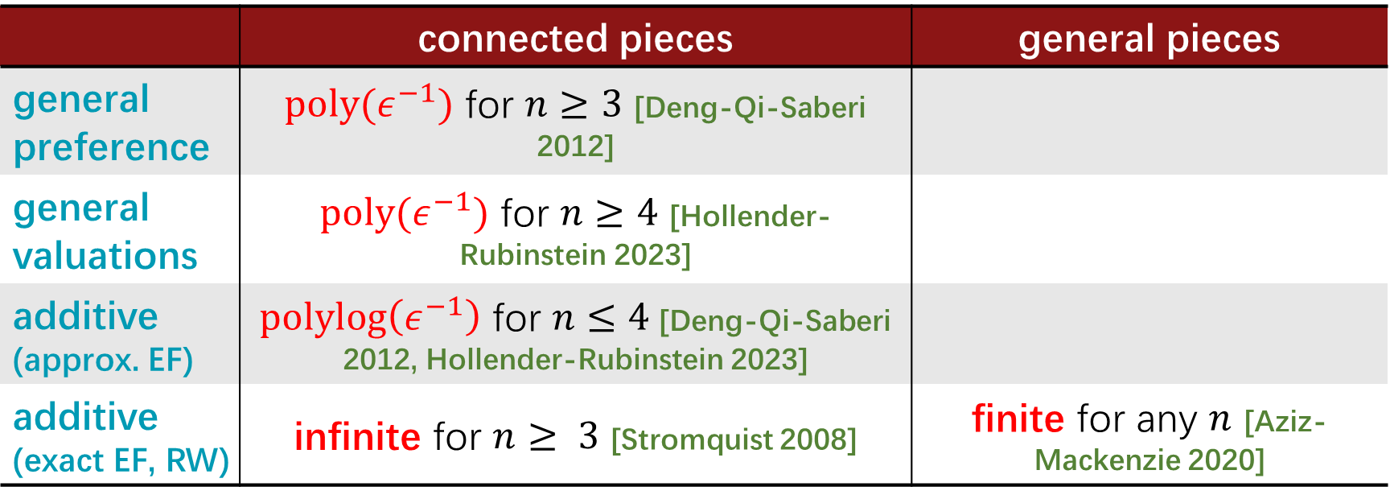
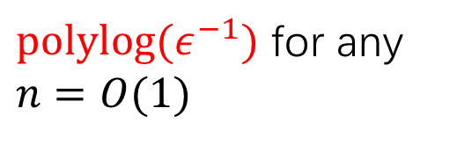


Applications: Cake-Cutting
 | connected pieces | general pieces
general preference | $poly(ε^{−1})$ for $n≥3$ [Deng-Qi-Saberi 2012]
general valuations | $poly(ε^{−1})$ for $n≥4$ [Hollender-Rubinstein 2023]
additive (approx. EF) | $polylog\left(ε^{−1}\right)$ for $n≤4$[Deng-Qi-Saberi 2012, Hollender-Rubinstein 2023]
additive (exact EF, RW) | infinite for $n≥ 3$ [Stromquist 2008] | finite for any $n$ [Aziz-Mackenzie 2020]
$poly(ε^{−1})$ for $n≥3$ and $k=O(1)$ (ours)
???
$polylog(ε^{−1})$ for any $n=O(1)$
Note: for $n=2$, the divide-and-choose protocol solves all four cases in log$\left(ε^{−1}\right)$ or $O(1)$ queries

Slide 33


Applications: Cake-Cutting
Technically,
$k$ cuts $⇔$ points in $k$-simplex
# $ε$-EF agents $⇔$ # colors in a size-$ε$ simplex
For general pieces: # $ε$-EF agents $=n≪$ $k+1$
Extensions
Finding an allocation in which at least $n^{′}≪n$ agents are $ε$-EF requires $poly\left(ε^{−1}\right)$ queries
Match the hardness for approximate Sperner
Finding a small simplex with $k’≪k+1$colors is hard

Slide 34


Application: Consensus Halving
Problem Formulation
Interval $[0,1]$, $n$ agents, each with an evaluation $v$ over subsets of $[0,1]$
Goal: cut $[0,1]$ into $n+1$ pieces and partition into $I^{+}$ and $I^{−}$ such that
$$∀i∈\left[n\right], \left|v_{i}\left(I^{+}\right)−v_{i}\left(I^{−}\right)\right|≤ε$$

Slide 35


Application: Consensus Halving
O(1) agents
n agents
PPA-complete even when $ε=Ω\left(1\right)$ and the valuations are additive [Deligkas, Fearnley, Hollender, Melissourgos ’2025]
Even if each valuation is 3-block uniform
With $n+n^{1−δ}$ cuts
 | $n$ cuts | $k$ cuts
general | $poly(ε^{−1})$ for $n≥2$ [Deligkas, Filos-Ratsikas, Hollender ’2022] | $poly(ε^{−1})$ for $k≥n≥2$ (ours)
monotone | $polylog\left(ε^{−1}\right)$ for $n=2$ $poly\left(ε^{−1}\right)$ for $n≥3$ [Deligkas, Filos-Ratsikas, Hollender ’2022] | $poly\left(ε^{−1}\right)$ for $k≥n≥3$ (ours)

Slide 36


Application: Consensus Halving
Technically,
$k$ cuts $⇔$ $k+1$ coordinates
Each coordinate corresponds to the length of one piece
# $ε$-satisfied agents $⇔$ # $ε$-approx. zero coordinates in $f(x)$
For more pieces: # $ε$-satisfied agents $=n≪$ $k$
Extensions
Finding a partition s.t. at least $3$ (monotone) / 2 (general) agents are $ε$-satisfied requires $poly\left(ε^{−1}\right)$ queries
Match the hardness for approximate Borsuk-Ulam
Finding a point with $k’≪k$ zero coordinates is hard

Slide 37
Conclusions

Slide 38

Conclusions
Takeaway messages
Although some topological theorems give direct corollaries in a high-to-low dimensional manner, they don’t actually reduce the computational complexity
Zeros for Borsuk-Ulam: $f:𝒮^{100}→ℝ^{2}$
Find a point fixed in 2 coordinates for Brouwer: $f:{[0,1]}^{100}→{\left[0,1\right]}^{100}$
Applications
For Ham Sandwich: as hard for more cuts, fewer satisfied agents and more dimensions
For Cake Cutting and Consensus Halving: as hard for more cuts and fewer satisfied agents

Slide 39

Open Problems
Envy-free cake cutting
General valuations: $3$-out-of-$k$
Additive valuations:
$n≥5$ agents and connected pieces
Large $n$ (RW model): best known bounds $(Ω\left(n^{2}\right), n↑↑6]$
Consensus Halving
Additive valuations for $O(1)$agents
Additive valuations for large $n$ and $1.01n$ cuts

Slide 40


Conclusions
Takeaway messages
Although some topological theorems give trivial corollaries in a high-to-low dimensional manner, they don’t actually reduce the computational complexity
Zeros for Borsuk-Ulam: $f:𝒮^{100}→ℝ^{2}$
Find a point fixed in 2 coordinates for Brouwer: $f:{[0,1]}^{100}→{\left[0,1\right]}^{100}$
Applications
For Ham Sandwich: as hard for more cuts, fewer satisfied agents and more dimensions
For Cake Cutting and Consensus Halving: as hard for more cuts and fewer satisfied agents

